Slide 1
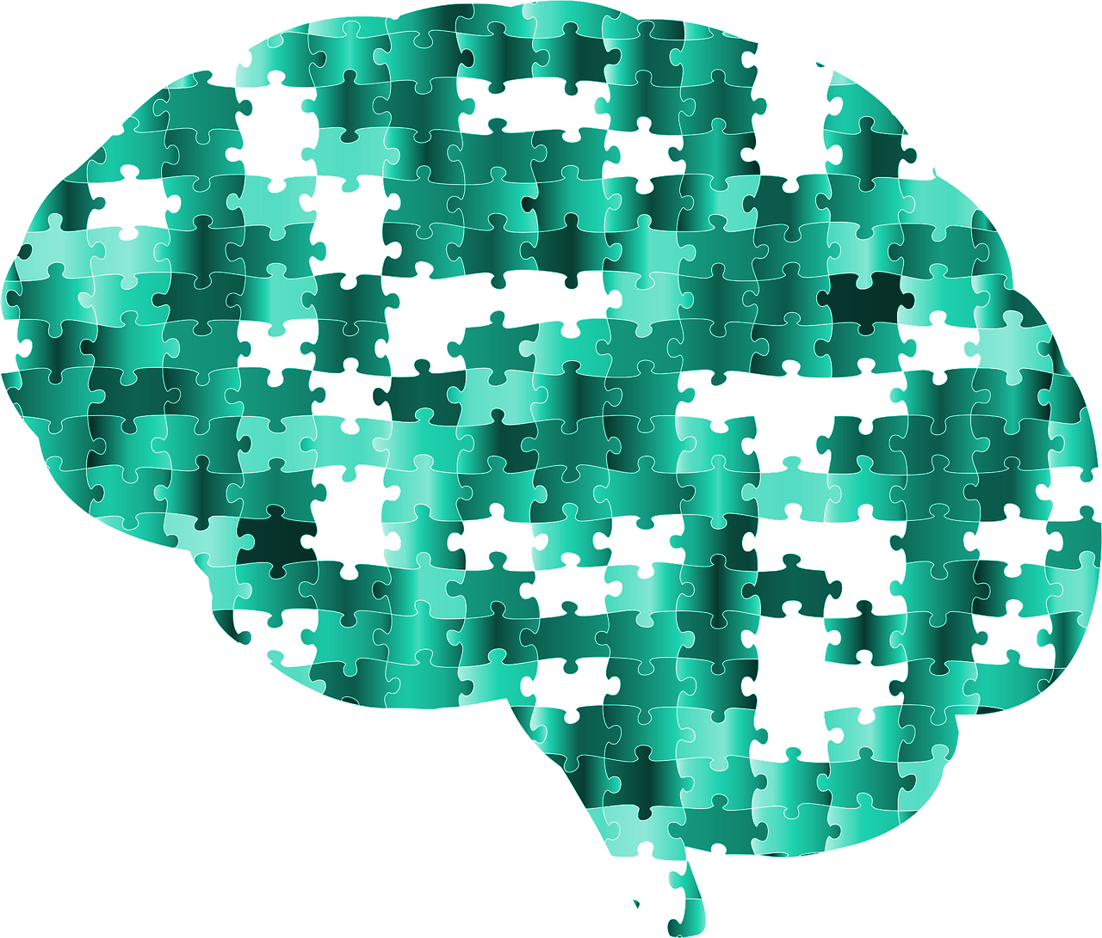

Capstone Project - Childhood ADHD Symptom Detection with Possible Solutions
24-1-D-6
By the students:
Safwan Halabi - 213784127
Bishara Bisharat - 208261990
By the mentor:
Dr. Natali Levi

Slide 2

AGENDA
INTRODUCTION - ADHD
PROBLEM
EYE-TRACKING AND VOCAL ANALYSIS
OUR PRODUCT
MOTIVE AND EVALUATION

Slide 3
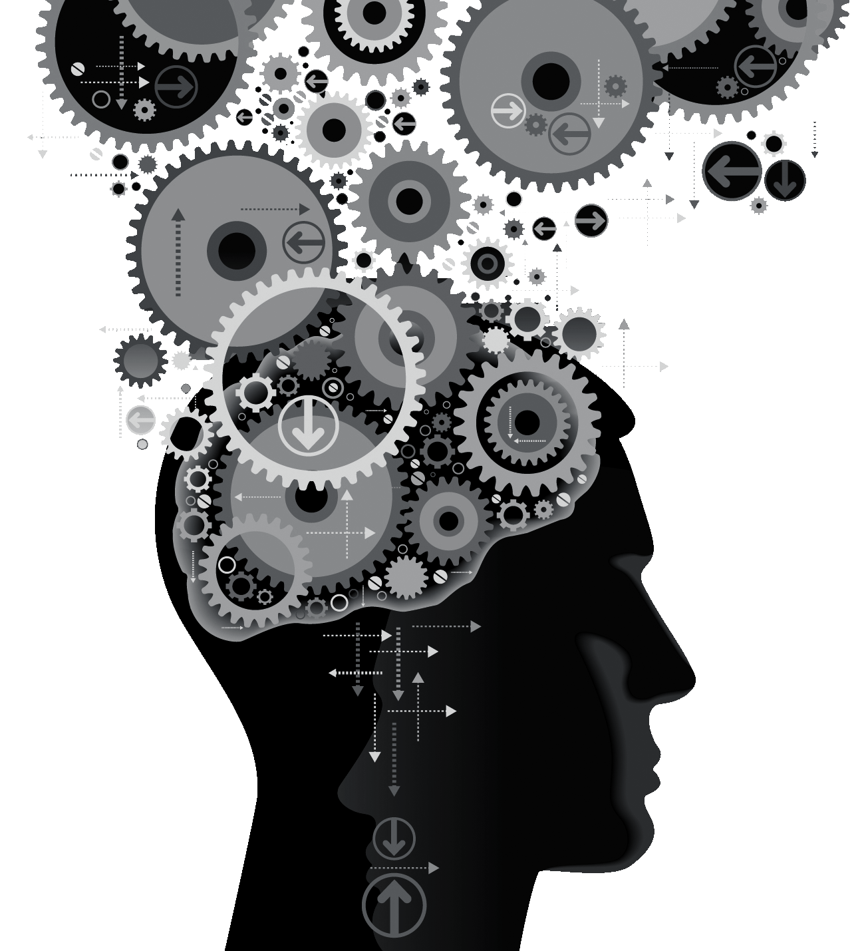
INTRO - ADHD
Attention Deficit Hyperactivity Disorder, or ADHD, is a common neurodevelopmental disorder that affects millions of children and adults worldwide. It can manifest in challenges with focus, attention, and impulsivity. While sometimes portrayed as simply excessive energy, ADHD can impact daily life at school, home, and work. By understanding ADHD, we can create better support systems and unlock the potential of those who experience it.

Slide 4



Types of ADHD
HYPERACTIVITY/
IMPULSIVITY
INATTENTION
COMBINED
Talkativeness
Excess energy
Recklessness
Fidgets & squirms
Misses details
Loses focus easily
Forgetful often
Dislikes long tasks
Inattentive
Hyperactive
Impulsive
(Shares symptoms with the other types)

Slide 5



CURRENT TECHNOLOGIES
QUESTIONNAIRES AND REPORTS
Provide Insights: Answers can reveal patterns and areas for further exploration during a professional evaluation.
Self-Reported: Accuracy relies on the patient’s/caregiver’s honest assessment of your experiences.
INTERVIEWS
Core of Diagnosis: Interviews with a mental health professional are the cornerstone of ADHD evaluation.
Interactive Process: Unlike questionnaires, interviews are a two-way street.
PHYSICAL EXAMINATION
Ruling Out Other Causes: helps to identify medical conditions that can mimic ADHD symptoms
Not Diagnostic for ADHD: The exam itself cannot diagnose ADHD. It's focused on general health and ruling out alternative explanations.

Slide 6

ADHD ASSESSMENT
DIFFICULTIES
Getting a diagnosis for ADHD can feel like navigating a maze. Here's why:
Multi-Step: Interviews, ratings, & tests (may be needed) to assess symptoms thoroughly.
Time Commitment: Weeks or months of appointments and waiting for results can be frustrating.
Financial Burden: Costs vary depending on location, insurance, and specialists involved. Out-of-pocket expenses are a possibility.

Slide 7


TIMELINE OF
ADHD DIAGNOSIS
JUN 20XX | Initial Discussion with Doctor
JUL 20XX | Finding Qualified Provider
JUL 20XX | Coordinate a Meeting with Provider
OCT 20XX | Conduct Diagnosis
DEC 20XX | Receive Evaluation and Treatment Plan

Slide 8
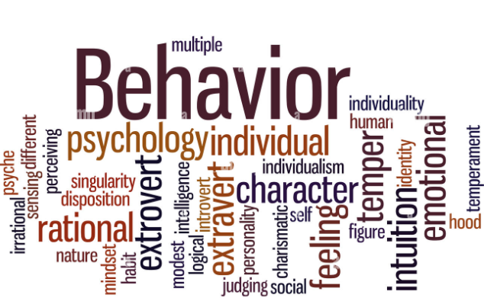
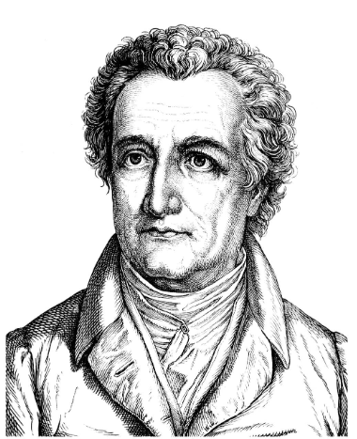
Behavior is the mirror in which everyone shows their image.
“
”
Johann Wolfgang von Goethe

Slide 9
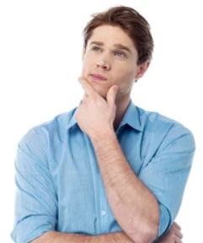
Behavioral Patterns
Inattention: Frequent "gaze drifting" - their eyes might wander to objects, out the window, or around the page, missing crucial information.
Hyperactivity: Increased scanning patterns - rapid jumps of gaze all over a screen or environment, struggling to fixate on any one area for a long time.
Disorganization: Challenges focusing on relevant details during tasks - spending more time looking at irrelevant parts hindering task completion.
Distractibility: Increased attention drawn to peripheral stimuli - their gaze is readily pulled away by background noise or movement in the environment.
If only we can observe these patterns, any ideas?

Slide 10
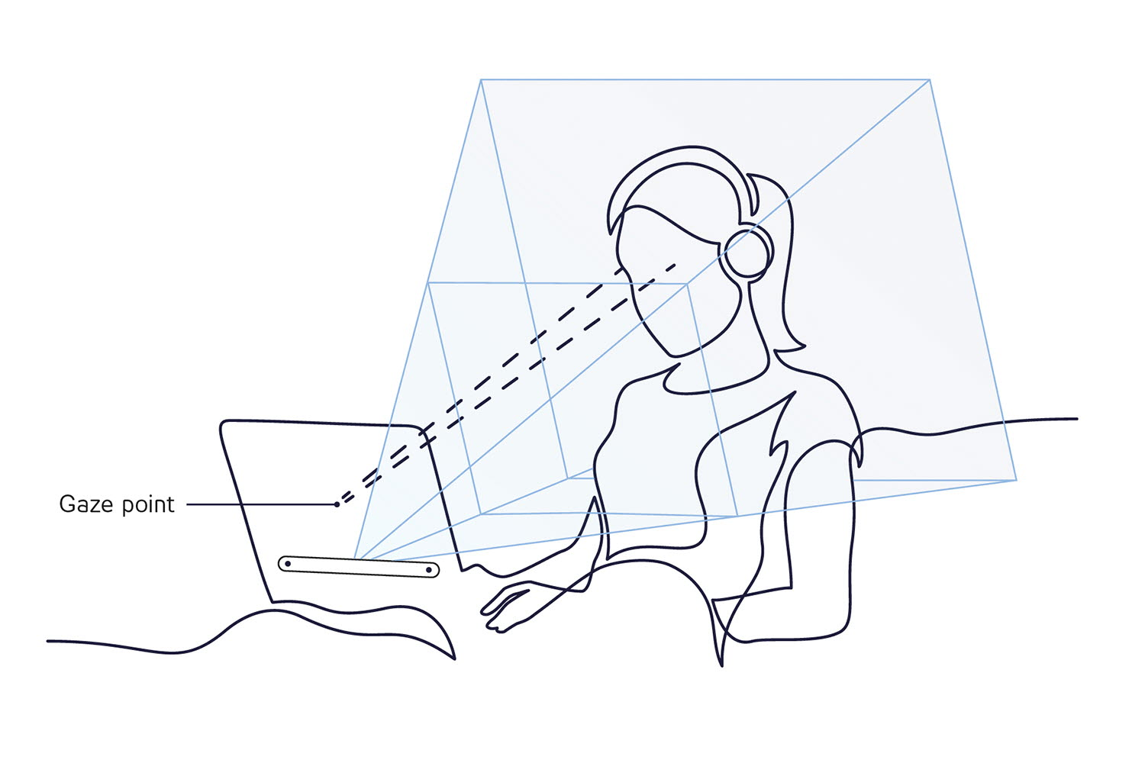

Eye-Tracking
Eye tracking, a computer vision application, analyzes video feeds to gather data on eye movements like fixations, saccades, and pupil dilation. Specialized algorithms track the pupil and its movement relative to the eye (often using visible light contrasts) to determine where we focus. This data unveils our visual attention, cognitive load, and even emotional responses, making it a valuable tool for optimizing user interfaces, marketing campaigns, and most importantly, unlocking the secrets of human cognition.

Slide 11
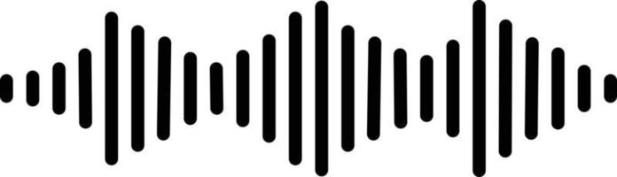

Vocal Analysis
Vocal analysis for ADHD is a developing field that examines how a person with ADHD speaks in order to potentially identify signs of the disorder.
What is analyzed: Researchers look at characteristics of a person's voice, such as pitch, loudness, and steadiness.
Potential findings: Studies suggest people with ADHD may speak with: Increased loudness, lower pitch or strained or breathy voice.
Usefulness: Vocal analysis shows promise as a complementary screening tool for ADHD diagnosis in children.

Slide 12
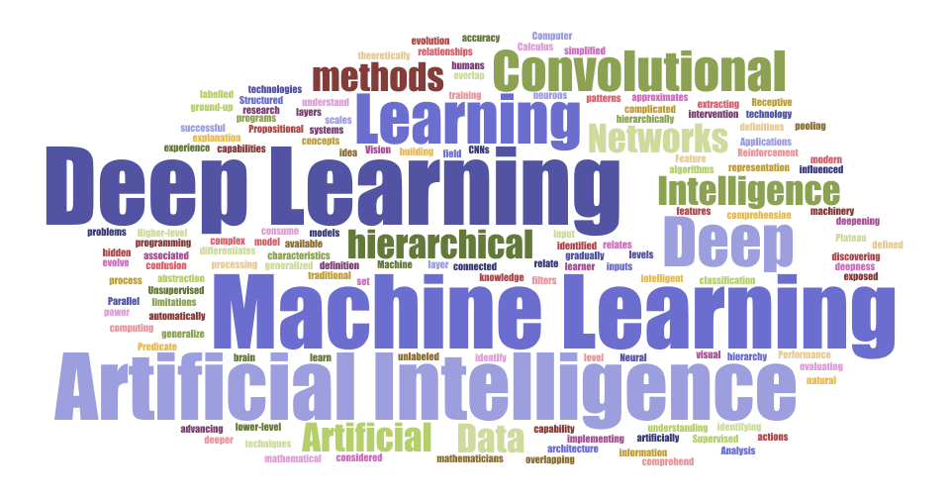
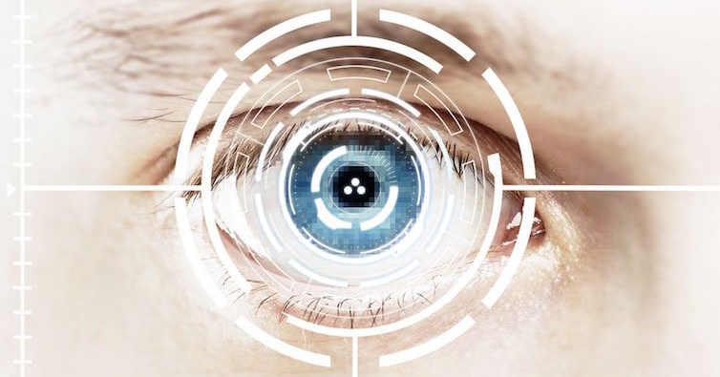
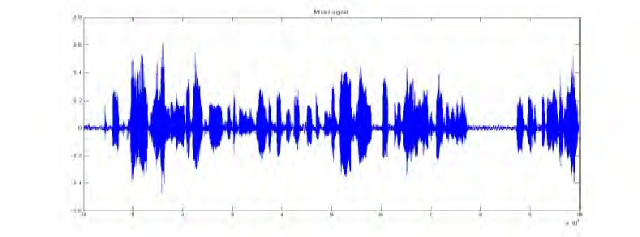
Our Product
Our approach to the problem and our experience led us towards a data-analysis and AI solution utilizing Eye-Tracking, Vocal Analysis along with a Deep-Learning model for processing and analysing the results based on scientific evidence and to provide possible solutions.

Slide 13
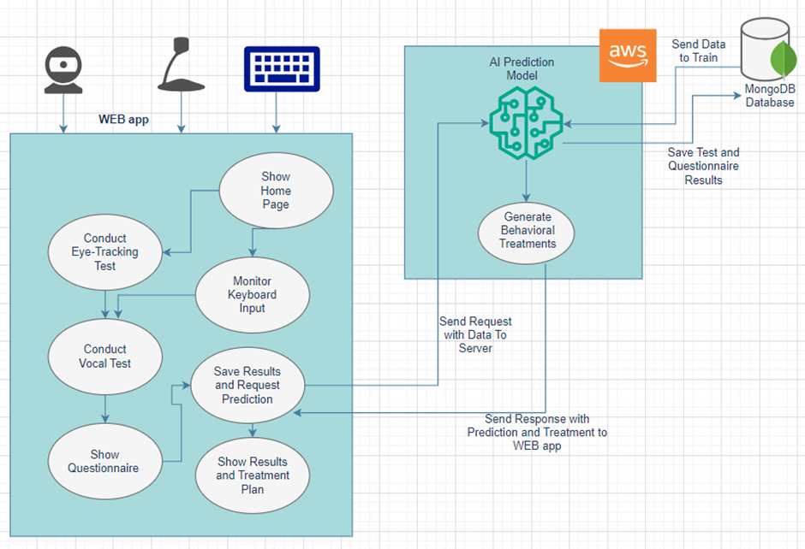
Architecture
Notes:
Say we are going to explain each individual section

Slide 14
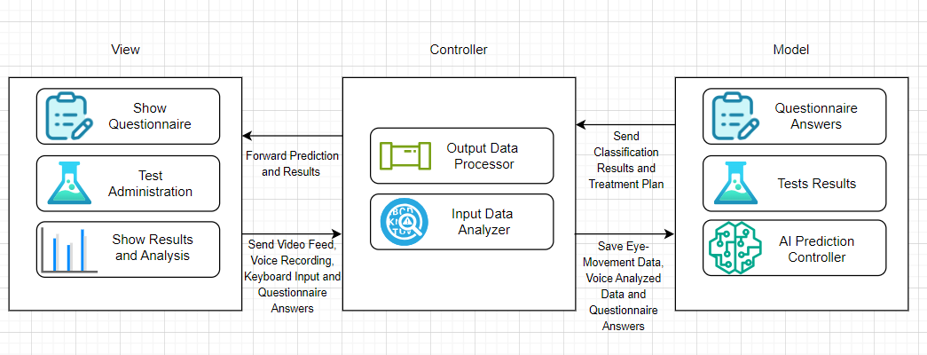
MVC Model

Slide 15




Libraries Employed
PyTorch
PyMongo
Librosa/
my-voice-analysis
OpenCV

Slide 16




Web App
af
For our Web App we decided to go with a standard Client-Server architecture, we will expand on each section of the Web App in the following slides.
For the frontend we will use React/WIX to both build the pages dynamically and to style them.
For the backend we will use Django to handle requests and to run the server-side, we then deployed said server onto AWS.

Slide 17
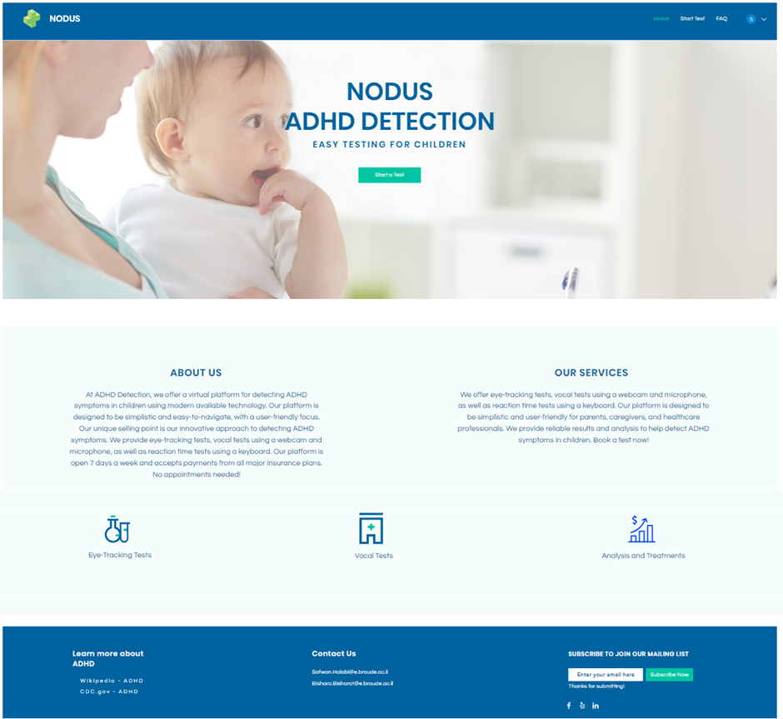

Frontend
Simplistic
Accessible
Functional
We designed the frontend to be easy-to-use, intuitive and efficient.

Slide 18
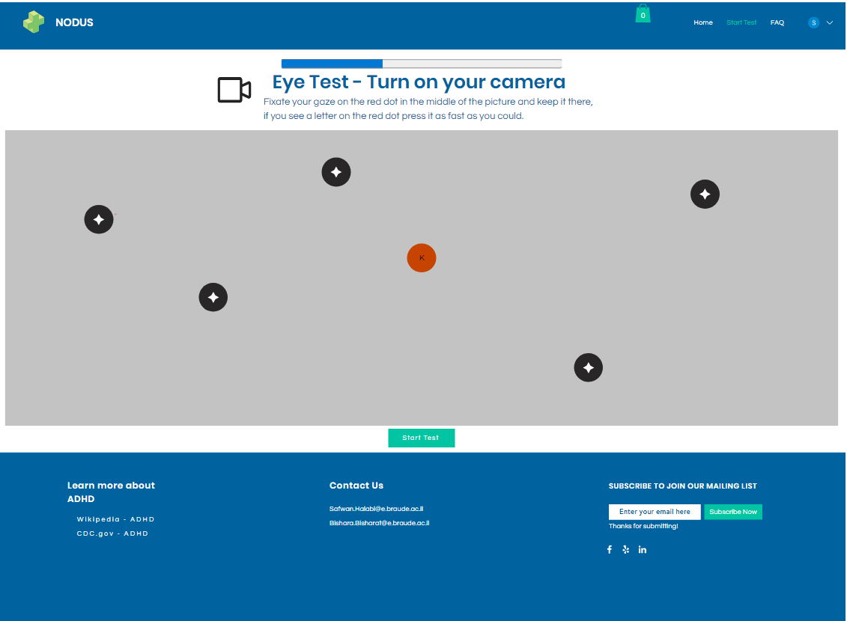
Eye-Tracking Test

Slide 19
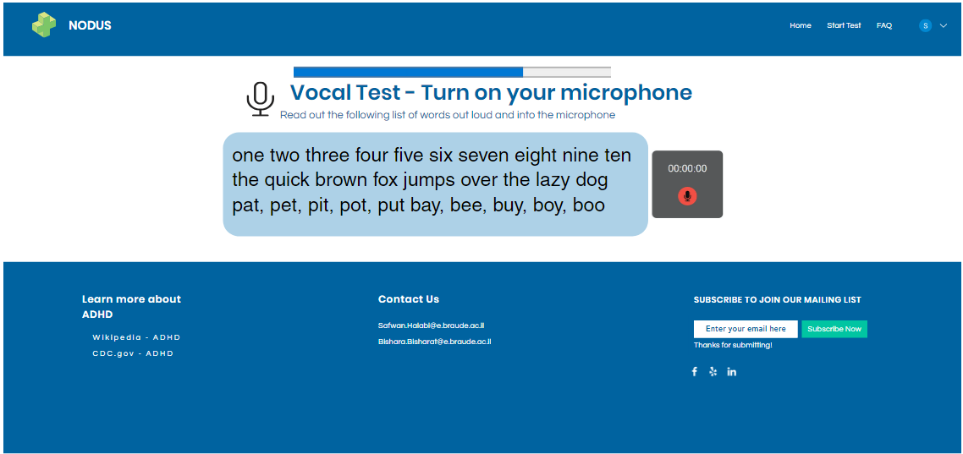
Vocal Test

Slide 20




Backend
The backend will be run on AWS
Django will be used to implement backend.
D-L Model is run in the backend to process and analyze data received from the test results, which will then be passed to the database to store relevant information about the test.
DL Model
MongoDB

Slide 21

Data Availability
Our DL model will be trained on clinical research data found in research papers [5,6], said data is divided into 2 groups “Vocal Analysis” and “Eye-Movement” data.
We will construct a structured dataset by combining these 2 groups along with data gathered from “DSM-V” [7] to use as questions on the questionnaires.
This combined dataset will allow our DL model to identify patterns of ADHD and develop a more comprehensive understanding of a patient's state than by examining each factor individually.

Slide 22
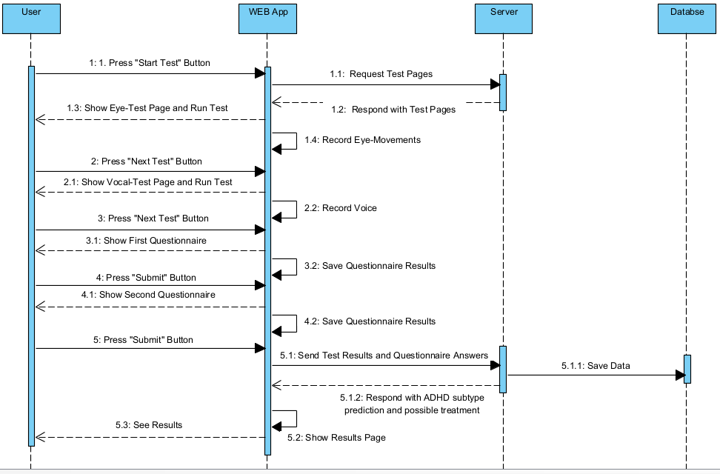
Sequence Diagram

Slide 23
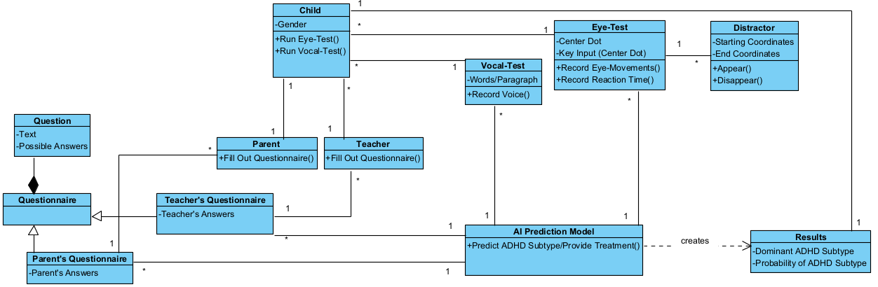
Class Diagram

Slide 24
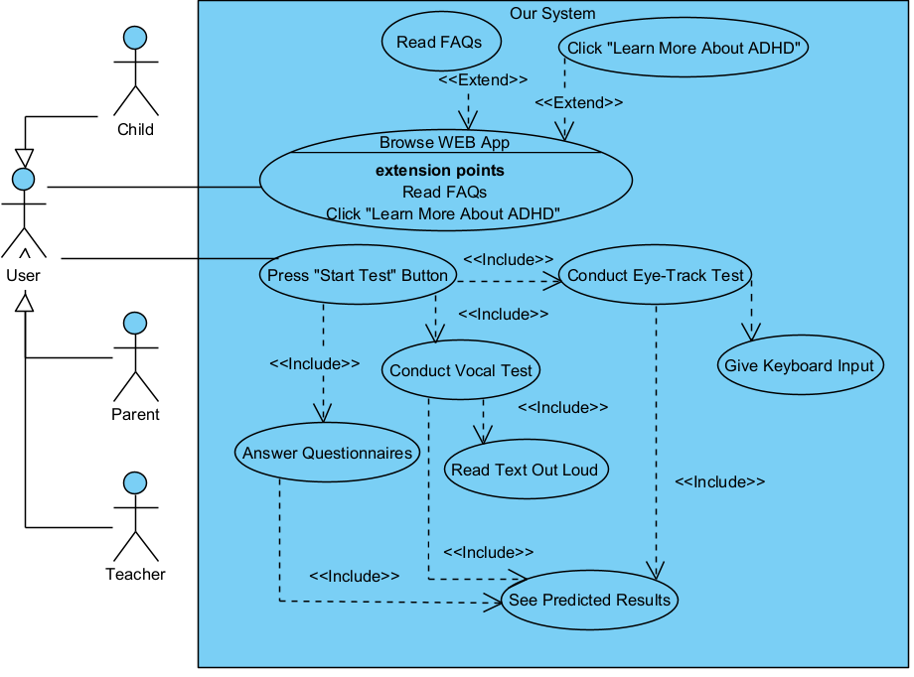
Use-Case Diagram

Slide 25

Our Motives
As individuals with ADHD ourselves, we've experienced firsthand the challenges of diagnosis and management. This personal connection fueled our passion to develop a solution that could empower others navigating ADHD. We believe this project has the potential to improve lives and bridge the gap for those seeking a more objective approach to understanding ADHD.

Slide 26

Our Vision
Our vision is to create a comprehensive ADHD detection system that leverages the best of current technologies.
This future-proof design allows us to seamlessly integrate new advancements in these fields.
Our architecture is flexible enough to accommodate the inclusion of entirely new detection methods, should a promising field emerge in the future of ADHD identification.

Slide 27


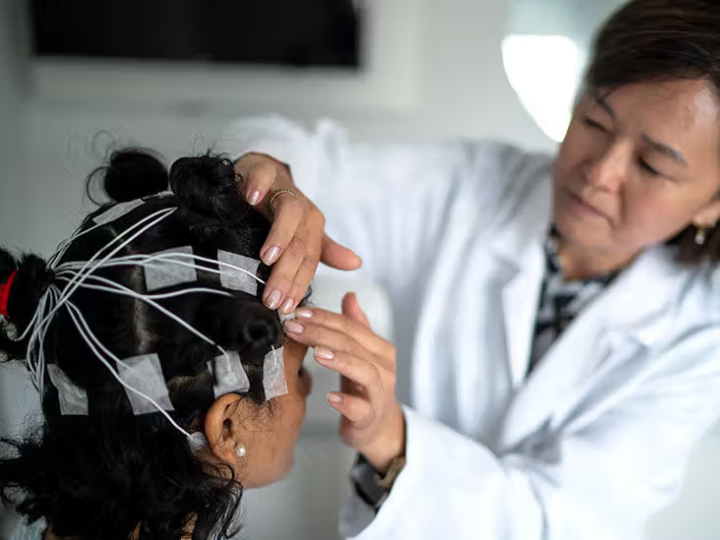
What Makes Us Special?
Our product is the first to incorporate the use of multiple input streams of behavioural data to detect symptoms.
As opposed to MOXO-d-CPT [4] and [3] which only takes in one parameter.
Other research such as [1,2] leverage environmental and medical variables (EEG signals) and data as parameters for ML systems to detect ADHD.

Slide 28
THANK YOU
References:
Maniruzzaman, M., Shin, J., & Hasan, M. A. M. (2022). Predicting children with ADHD using behavioral activity: a machine learning analysis. Applied Sciences, 12(5), 2737.
Maniruzzaman, M., Shin, J., Hasan, M. A. M., & Yasumura, A. (2022). Efficient Feature Selection and Machine Learning Based ADHD Detection Using EEG Signal. Computers, Materials & Continua, 72(3).
De Silva, S., Dayarathna, S., Ariyarathne, G., Meedeniya, D., Jayarathna, S., Michalek, A. M., & Jayawardena, G. (2019, July). A rule-based system for ADHD identification using eye movement data. In 2019 Moratuwa Engineering Research Conference (MERCon) (pp. 538-543). IEEE.
Berger, C., Lev, A., Braw, Y., Elbaum, T., Wagner, M., & Rassovsky, Y. (2021). Detection of feigned ADHD using the MOXO-d-CPT. Journal of Attention Disorders, 25(7), 1032-1047.
Ranjan, R., Naqvi, T., Mishra, P., & Gaur, S. S. (2022). Analysis Of Voice In Children Among ASD & ADHD-A Comparative Case Study. International Journal of Advance Research And Innovative Ideas In Education, 8(3), 667-673.
Eyes are the window to the mind: Eye-tracking technology as a novel approach to study clinical characteristics of ADHD. Psychiatry Research, 290, 113135.
Bishara Bisharat
Safwan Halabi

